Slide 1
Who is a Counselor ?
"A Counselor is some one who tells you the time looking at the watch on your wrist"

Slide 2
Cycle of Counselling
A,B,C,D,E
A= Ability
B=Bargaining
C=Commitment
D= Deliver
E= Earn

Slide 3

Funding

Slide 4
Scholarships and Institutional Funding FOR NEPALESE STUDENTS
ABROAD STUDIES

Slide 5
What is Funds
“Funds are an award of financial aid for a student to further their education. Funds are awarded based upon various criteria, which usually reflect the values and purposes of the donor or founder of the award. Funds are not required to be repaid”

Slide 6
Type of Funding
Funding for International Students
Scholarship
Grant
Fellowship
Stipend
Assistantship

Slide 7
WHY SCHOLARSHIP/FUNDING
The tuition fees in the international context are quite high
Might not be affordable by all
Funding eases the financial burden both for parents and students
Students can focus more on studies thus getting better results
Motivates students for better results
Job Market gives preference to funded students.

Slide 8
Read the given conditions and chose the best options
1. A student has got admission and also got $20,000 (Scholarship ) per annum by the same University.
a. Institutional scholarship b. Private Sector Scholarship
c. Full Time Scholarship
d. All of Above
2.A Student has got admission and also got $60,000 by cash in Kent State University .
a. Fellowship
b. Scholarship
c. Grant
d. All of above

Slide 9
Cont..
3. A Research team has got $24,500 funds on the basis of their research proposal on wild animal.
a. Fellowship
b. Scholarship
c. Assistantship
d. Grant
4 . A Student has got admission with $ 40,000 funds per annum on quarterly basis from East Tennessee State University .
a. Fellowship
b. Assistantship
c. Stipend
d. Grant

Slide 10
Cont…
5.When was the first Nepalese students had got Fulbright scholarship:
a. 1953
b. 1952
c. 1955
d. 1986

Slide 11
Cont..
Full Form of Common App
a. Common Application
b. Common Apply
c. Common Apple
d. Common Applyapplicaton

Slide 12
Cont..
6.Which is not the feature of Assistantship ?
a. provided by the university itself (Department)
b. falls under Human Resource/Employment division of the university
c. Assistantship provided by Government
d. Both A and B

Slide 13
Cont..
7.How many students have got Fulbright Scholarship (Master program)for 2020-2021 ?
A. 4 students
B. 5 students
C. 10 students
d. 6 students

Slide 14
Cont..
8.An Undergraduate student is eligible for
a. Scholarship
b. Grants
c. Assistantships
d. Teaching Assistantship

Slide 15
Cont..
9. Which one is Japanese Scholarship ?
a. Australia Awards Scholarships
b. (Monbukagakusho MEXT) Scholarship
c. Endeavour Scholarships

Slide 16
Cont….
10.Grant is an ………………. type of funds.
a. Only Academic
b. Only Non Academic
c. Either Academic or Non Academic

Slide 17
Cont…
11. To get scholarship by an undergraduate student in USA, how much should be scored in the Essay section of New SAT?
a. not specified
b. more than 5 out of 6
c. more than 3 out of 6
d. more than 4 out of 6

Slide 18
Cont..
12. Which one is the right email address for inquiring about Australian Award ?
a. inquiries@australiaawardsnepal.org
b. info@australiaawardsnepal.org
c. admissions@australiaawardsnepal.org
d. scholarship@australiaawardsnepal.org

Slide 19
Cont..
12. Which is not Australian Scholarship ?
a. Australia Awards Scholarships
b. Commonwealth Scholarship
c. Endeavour Scholarships

Slide 20
OBJECTIVES
At the end of this session participants will be able to answer the following questions:
1. Difference between scholarship and other funding.
2. What are the different types of funding provided for Nepalese students, going abroad?
3. Describe the criteria for scholarship and funding
4. Describe and counsel the students regarding the funding they are eligible for.
5. Guide the students according to their eligibility.
6. Should be able to do their own research in the required area

Slide 21
What is a Scholarship? A scholarship is an award of financial aid for a student to further their education. Scholarships are awarded based upon various criteria, which usually reflect the values and purposes of the donor or founder of the award. Scholarship money is not required to be repaid.
Granted by the government/ some foundations/ university
basically for tuition
sometimes for some other costs as well
can be full or partial
For both Undergraduate and Graduates
Certain prerequisites have to be fulfilled
scholarship amount is unlike a loan and need not be paid back
either in installments or deducted from tuition fees
Conditions of students performance may apply for continuity

Slide 22
Types of Scholarship
Institutional scholarships. Higher education institutions award institutional scholarships. The amount awarded is often based on academic merit and need. Things to know or do: Contact your school for a listing of specific scholarships available.
Private sector scholarships. Private foundations, companies, and service groups award scholarships. There are thousands of such scholarships available and the amount awarded varies widely depending on the provider. Private scholarships can be payable to the student, the college, or both.

Slide 23
What is a Grant? Grants are non-repayable funds or products disbursed by one party (grant makers), often a government department, corporation, foundation or trust, to a recipient, often (but not always) a nonprofit entity, educational institution, business or an individual. In order to receive a grant, some form of "Grant Writing" often referred to as either a proposal or an application is required.
a non-refundable amount given by non-profit organizations
Usually tax-free
Mostly provided by the government
not given for a general academic degree but for certain specific projects
students are required to submit the project reports to the concerned authority at the end
generally allocated for research studies like Masters or PhD programs

Slide 24
Cont….
First submit a proposal to the concerned authority
donor has to accepts the proposal
If accepted fund to complete the project shall be granted.
can also be given to entrepreneurs, or victims of natural disaster as well.
no any specific prerequisites to get grants
Acceptance of proposal is the only requirement

Slide 25
What is a Fellowship?
almost like scholarships
awarded to the graduate students
Money need not be returned to the authority either in cash or kind
students getting this fund need not work on campus or pay back the loan
Amount generally exceed the total tuition and living cost.
Quite rare for Nepalese students

Slide 26
What is a Stipend?
This comes from a Latin word “Stipendium”, which means “soldiers pay”.
Generally provided to graduate students
funds paid at fixed and regular intervals
to meet the expenses of students
tends to be less than salary
Scholarship is onetime payment while stipends are fixed regular income
Scholarships usually covers tuition fee whereas stipends maybe given for living expenses, books, etc.
Need not be paid back

Slide 27

What is an Assistantship? An assistantship is a form of financial assistance provided to graduate students through part-time academic employment. Assistants are paid a stipend and/or receive tuition remission (free tuition) in exchange for tasks they perform for a faculty member, the department, or the college. Teaching assistantships provide aid in exchange for teaching activities, such as assisting a professor by conducting lab or study groups, preparing lectures, and grading.
Generally graduate assistantships provided to Graduates’ level students
During admissions at the universities
provided by the university itself (Department)
falls under Human Resource/Employment division of the university
These are employment opportunities for students

Slide 28
Assistantship …cont…
student needs to pay for their tuition and other cost by themselves
however the amount earned from their services helps them to meet their cost
Some of them might be able to save as well
assistantship ensures that the student works for 20 hours per week
Students are paid fixed amount (like salary)
assistantships are lower than salaries

Slide 29
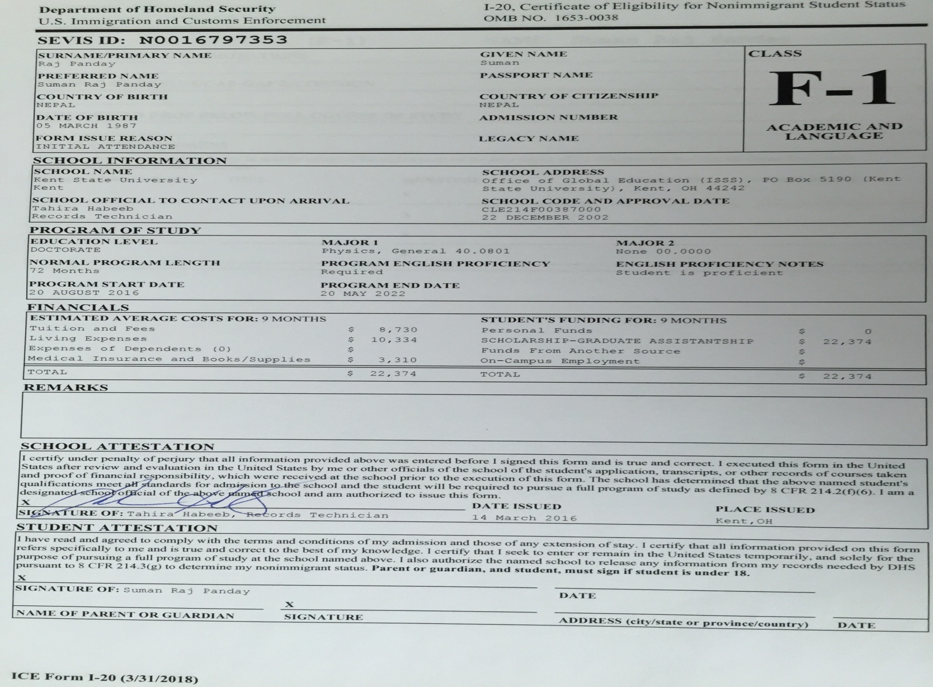
Sample I20 with Assistantship

Slide 30
Types of Assistantships
Teaching Assistantships,
help younger students to do their homework
grade their assignments
teach them in place of the professors
Research Assistantships
help the faculty in their research
Or become a full partner in research with the professor
Administrative Assistantships.
help in the administrative work of the university,
like admissions, record keeping, etc

Slide 31

Sample I20 with GA

Slide 32
Procedure to apply for fund support
Scholarship
Know the Deadlines
Know the pre-requisites (Entry requirement)
Submit a complete packet
Keep track of your transcripts and syllabus. Some universities want a credit evaluation made (WES for USA, )
Impressive Resume
Recommendation Letters (Minimum 3- 2 academic)
Certificates of Voluntary service /Scout , etc
Complete SOP (According to the university requirement)
Simple email id with some part of name included
(Not rocku@gmail.com)
Make copies of the entire packet before submitting as colleges may ask for some information later

Slide 33
How to get Assistantships
Meet the minimum admission requirements
First Division pass certificate
Toefl ibt – 80 (minimum) (speaking -22 & writing – 22) or IELTS
GRE/ GMAT – above 300 (conditions apply)
Subject GRE (conditions Apply )
SOP/Personal Essay/ application Essay/ Letter of Interest
Correspond with the related faculty
Head of the Department
Professor in a related program
Once the assurance is granted – apply for admissions
With complete documentation

Slide 34
Test for Funding
SAT:- www.collegeboard.com
SATII: www.collegeboard.com
GRE: www.ets.org/gre
Subject GRE: www.ets.org/gre
GMAT: https://www.mba.com/exams/gmat

Slide 35
Common App
The Common Application (informally known as the Common App) is an undergraduate college admission applicationthat applicants may use to apply to any of more than 700 member colleges and universities in 49 states and the District of Columbia, as well as in Canada, China, and many European countries. Member colleges and universities that accept the Common App are made up of over 100 public universities, 10 Historically Black Colleges and Universities, and over 250 institutions that do not require an application fee.

Slide 36
Common App
Founded: 1975
Location: Arlington, Virginia, United States
Purpose: Higher-education application processing
Type of business: Non-profit NGO

Slide 37
GOVERNMENT SCHOLARSHIPS: for Nepalese Students
The Fulbright Program for Masters or PhD in US
The Hubert H. Humphrey Fellowship Program awarded for US
British Chevening Scholarships for a one-year Master’s in UK
The Commonwealth Scholarships for Master’s and PhD study in the UK.
Australia Awards Scholarships,
The Endeavour Postgraduate Awards for Australia
The German Academic Exchange Service (DAAD) for postgraduate

Slide 38
Countries providing Scholarships
United States of America
United Kingdom
Australia
Sweden
Netherland
France
Korea
Germany …..and more…

Slide 39
QUICK GLIMPSE
POPULAR SCHOLARSHIP PROGRAMS

Slide 40
Fulbright Scholarship
Common AP
DAAD Scholarships - an overview
Erasmus Mundus Joint Masters scholarships
Australia Awards scholarship
Japanese Government (Monbukagakusho MEXT) Scholarship

Slide 41

Fulbright Student Scholarship Program
The U.S. Educational Foundation in Nepal (USEF-Nepal or the Fulbright Commission) welcomes applications from Nepali students for the Fulbright Foreign Student Program (FFSP) for Master’s level study in the U.S. Approximately 4000 foreign students from 160 countries worldwide receive Fulbright scholarships each year. The FFSP provides all expenses (including travel) for a Master’s degree program of up to two years at selected U.S. universities, in any field except Medicine and Nursing.

Slide 42
Fulbright Student Scholarship Program
Granted by the government of USA
Starts from mid February every year
For the Fall Intake
For Graduate Students
Covers all expense for up to 2 yrs of study
Available for all courses except medicine

Slide 43
Eligibility for Fulbright
Must be a Nepalese Citizen
Must have a 4 yrs Bachelors or 16 yrs of education
Minimum 54% (non-technical)/ 62% (science and technical)
Toefl ibt – 88
Age - Under 40 years
Sound Health
Full Time work experience of 3 yrs (Male). 1 yr (Female)

Slide 44
In 1952, Mr. Ram Chandra Malhotra and Mr. Yog Prasad Upadhyaya traveled from Nepal as the first Nepali Fulbright Scholar.

Slide 45
Fulbright Master’s Program Grantees 2019-2020
Ms. Chandni Jaishwal
Health Management and Policy Emory University, Atlanta, Georgia
Mr. Suyog Prajapati
Art History and Heritage Conservation Rutgers, New Brunswick, New Jersey
Ms. Trishna Rayamajhi
Wildlife Conservation- Wildlife Genetics Cornell University, Ithaca, New York
Ms. Sachina Sunuwar
Sustainable Agriculture and Climate Change Adaptation University of Massachusetts, Amherst, Massachusetts

Slide 46
Fulbright Master’s Program Grantees 2020-2021
Ms. Anita Khebang
Public Health
Mr. Pravin Kumar
Civil Engineering
Ms. Smita Poudel
Public Policy
Mr. Ashesh Shrestha
Economics
Ms. Priyasha Maharjan
Public Health

Slide 47

Erasmus Mundus Scholarships for International Students

Slide 48
Erasmus Mundus Scholarships for International Students
Provided by the European Union to study in European Countries
For Masters (116 courses) /PhD Degree (29 courses)
Major Fields of Study:
Agriculture and Veterinary, Manufacture and Construction, Engineering, Health and Welfare, Humanities and Arts, Science, Mathematics and Computing, Social Sciences, Business and Law.
Number of Awards: Not specified.
Scholarship value/inclusions:
offers full-time scholarships and/or fellowships that cover monthly allowance, participation costs, travelling and insurance costs of the students.
Scholarship amounts can vary
Eligibility:
each program defines its own selection criteria and admission procedures.

Slide 49

Australia Awards Scholarships

Slide 50

Australia Awards Scholarships
These scholarships provide citizens of Nepal with the opportunity to obtain a postgraduate qualification (Master’s or PhD) at an Australian tertiary institution. Scholarships in the Water Resource Management priority area are available at Master’s level only.

Slide 51
Cont..
Provider : Australian Government
Level :Masters/PhD Degrees
Deadline: varies, Feb-April every year
Study in: Australia
Eligibility:
To be eligible to receive a Scholarship, applicants must:
be a minimum of 18 years of age at the time of commencing the Scholarship
be a citizen of a participating country
not be current serving military personnel
Email: inquiries@australiaawardsnepal.org
Website:
Official Scholarship Website: http://www.dfat.gov.au/people-to-people/australia-awards/Pages/australia-awards-scholarships.aspx

Slide 52

DAAD SCHOLARSHIP IN GERMANY Deutscher Akademischer Austauschdienst German Academic Exchange Service

Slide 53
DAAD SCHOLARSHIP IN GERMANY
The German Academic Exchange Service (DAAD) provides scholarships in Germany for international students for a range of postgraduate courses at German Universities which aim at providing academically educated young professionals from developing countries with further specialized studies.

Slide 54
Cont..
Provided by Germany for Masters (MS) Degree
Deadline: Aug-Oct (annual)
Field(s) of Study: Updates in their related list
Number of Scholarships: Limited
Target group: International students from developing countries
Scholarship value/inclusions: Full and partial DAAD scholarships are available
Eligibility:
Holds a Bachelor’s degree (normally four years) in a related subject. Has completed an academic degree with 1st division
At least two years of related professional experience His/her academic degrees should normally not be more than six years old IELTS (Band 6) or TOEFL (80 internet based).
Could be additional eligibility requirements of the program applying to.

Slide 55
Japanese Government (Monbukagakusho MEXT) Scholarship
Provided by Japanese Government (Ministry of Education, Culture, Sports, Science and Technology)
Japanese government scholarship supports foreign students who study in higher education institutions, selected on the recommendation of Japanese Embassy/Consulate General, University, or Authority.
Categories of the MEXT scholarship for 2024 (Embassy recommendation):
Postgraduate/Research Students
Undergraduate Students
Specialized Training College Students
Scholarship for Teachers
All application procedures for the MEXT Scholarships are conducted through the Japanese Embassy or higher education institutions in Japan.
No Application fees :

Slide 56
Other Popular Scholarship in Japan for 2024
MEXT Scholarship
Honjo International Scholarship Foundation
NIG Postdoctoral Fellowship
MEXT University Recommendation Scholarship
Joint Japan World Bank Graduate Scholarship Program
Robert S. McNamara Fellowships Program
IMU Breakout Graduate Fellowship Program
Schlumberger Foundation Faculty for the Future Fellowships
Rotary Peace Fellowships
Human Frontier Science Program Postdoctoral Fellowships
Aga Khan Foundation Scholarships
IIE-SRF Fellowship
Facebook PhD Fellowship
https://scholarshiproar.com/japan-scholarships-for-international-students/

Slide 57
Self evaluation
Are we able to answer the following questions?
1. Difference between scholarship and other funding.
2. What are the different types of funding provided for Nepalese students, going abroad?
3. Describe the criteria for scholarship and funding
4. Describe and counsel the students regarding the funding they are eligible for.
5. Guide the students according to their eligibility.
6. Should be able to do their own research in the required area

Slide 58
ANY QUESTIONS ??

Slide 59
ratna@nobelef.com
9841367262

